Slide 1
Constitution and Military Rule
in Pakistan

Slide 2
Constitution of Pakistan in 1956
In 9 January, 1956 a constitutional bill was arise in mass assemble which was accepted in 29 February. This constitution declares Pakistan as the Islamic Republican state. The constitution deserves the post of president only for Muslim. In 23 March 1956 the new constitution was effected. Iskandar Mirza elected as first president.

Slide 3
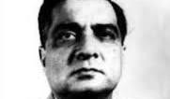
Iskandar Mirza as the first President
He was appointed Governor of East Pakistan in 1954. Ghulam Muhammad was succeeded by Iskander Mirza so he became the last Governor-General of Pakistan.
According to the
1956
Constitution, he became the
first President of Pakistan.

Slide 4
Iskandar Mirza as the first President
Iskander considered
Mirza was a power-hungry
person. He wanted to dominate the political scene of the country by any means possible.

Slide 5
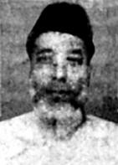
Death of Shahid Ali in the assembly
On 23 September 1958, an unfortunate incident occurred in the Provincial Assembly of East Pakistan.
A serious altercation and scuffle took place inside the Assembly in which the deputy Speaker Shahed Ali was severely injured and later died.

Slide 6
Political interference
Chaos in the Provincial Assembly of East Pakistan and the death of the Deputy Speaker provide the Pakistani ruling party an excuse for political interference in this region.

Slide 7
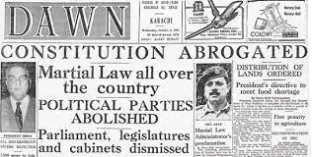
Martial law
7 October 1958, President Iskander Mirza introduced martial law by a declaration.
He suspend the Constitution, Legislative Assembly, Central and Provincial Ministries. He also prohibited political activities by banning all political parties.

Slide 8
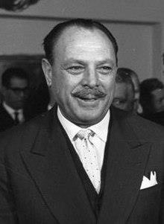
Martial Law
President Iskander Mirza abrogated the 1956 Constitution with the help of General Ayub Khan, the Chief Martial Law
Administrator.

Slide 9
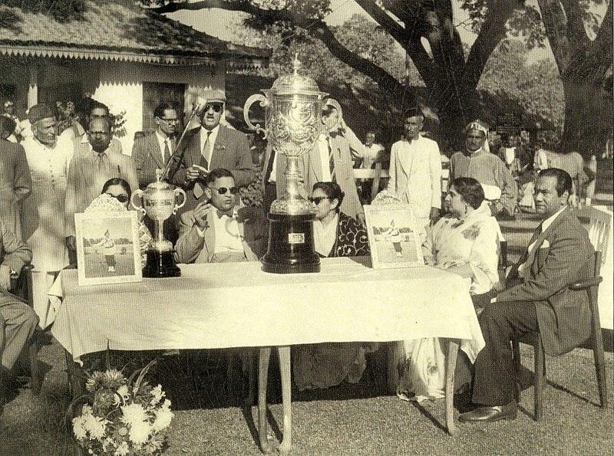
Pakistan was divided
Martial law
into number of military zones. Major General Umrao Khan was appointed Martial Law Administrate of East Pakistan.

Slide 10
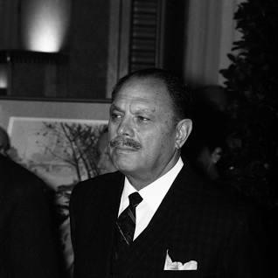
On 27 October 1958, General Ayub Khan removed Iskander Mirza and he himself assume supreme power as the President of Pakistan.
Ayub Khan
Ayub Khan remained Commander-in- Chief and the Chief Martial Law Administrator, thus becoming immensely powerful.

Slide 11
Basic Democracies
Basic Democracies a local government system. General AYUB KHAN President of Pakistan, introduced the concept of basic democracy under the Basic Democracies Order, 1959 having made an attempt to initiate a grass-root level democratic system.
The system of Basic Democracies was initially a five-tier arrangement. They were:
(i) union councils (rural areas), town and union committees (urban areas); (ii) thana councils (East Pakistan), tehsil councils (West Pakistan); (iii) district councils; (iv) divisional councils;
(v) provincial development advisory council.

Slide 12
The councils were consisted of elected and nominated members as well. There were 40,000 basic democrants in each part of Pakistan totaling the number to 80,000 in the country. Basic democrats member could elect the President and the members of the National and Provincial Legislative Councils.
Ayub Khan became the President for the following five
years after winning the confidence votes of these members.
Thus, he also gained the authority to formulate a constitution for the country.

Slide 13




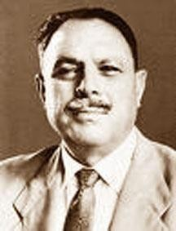



*

Slide 14
Martial Law lifted
In 1962 president Ayub khan lifted martial law and introduced a new constitution.
Abdul Monem Khan made the Governor of East Pakistan.
In 1964, presidential election held and Ayub Khan won against Fatima Jinnah, daughter of Mohammad Ali Jinnah.
He remained the president till 1969.

Slide 15
Characteristics of military rule
Military Rule in the sense of governing a country unconstitutionally by armed forces was very common during cold war period between 1940s and 1960s.
In staging a military rule by overthrowing an elected government, major role was often played by contending super powers.

Slide 16
In some countries, even in the absence of direct military rule, the army is often seen to have been asserting their influence in administration. Characteristics of military rule

Slide 17
Thank You

